Slide 1
To Special
“AUTISM IS NOT DISABILITY, IT’S A DIFFERENT ABILITY”

Slide 2
Group Members
Maliha Noushin Raida (170042001)
Nawshin Ulfat (170042081)
Zannatun Naim Sristy (170042043)

Slide 3
Big Concept

Slide 4
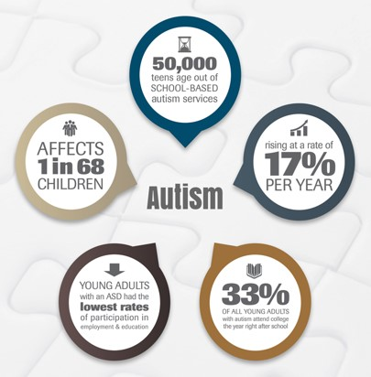
A
u
t
i
s
m

Slide 5
A social network based website to
Connect the autistic children with doctors and educators
Explore the hidden talent of autistic children
Advocacy for accepting autism

Slide 6
Requirements
UI Design
( HTML, CSS )
DataBase
( MySQL )
Version Control
( GitKraken )
Local Host
( APACHE )
Backend
( PHP, JavaScript )

Slide 7
Users
Family
Educator
Doctor
Everyone

Slide 8
Original plan(feature based)
Create account
Share post
Four types of profile
Message
Post categorization
Report post

Slide 9
Current Features
Account Creation
Notification
Promised feature
Post Categorization
Follow &
Friend
Post Share
Additional feature
Four types of Profile
Search
Post Report
Post Like & Comment
Main Admin
Message

Slide 10
Compare Changes(design based)
Original design | Current design
Fetching Four types of user’s detail after sign up pages. | Update Four types of user’s detail in about pages.
Post photos from post share. | Post photo from photo share which is different form post share section.
Page designed for autistic child. | Page designed for autistic child’s family member.

Slide 11
Proposed Working Plan
UI design
Database
Backend
Localhost
Modification
March 25,2019
April
10,2019
April 30,2019
May
5,2019
May
10,2019
June
5,2019
June
10,2019
June
13,2019
Database modifications & Post share
Message & Like & Comment
Notification & Follow & Friend
Search & Four types of profile
Main Admin & Post report
Post categorization & Testing
Create account
UI design
Actual Working Plan

Slide 12
Limitations
We don’t consider the reasons of report.
Password recovery.
Post save.

Slide 13
Project Demonstration

Slide 14
Challenges And Overcome
Four types of user’s profile and about
Build php file for each type of user.
Create table for each type of user.
Condition based location redirecting.
View post
Create table and showing post as the data of table.
Database Creation
Had to create, update & drop a single table for many times to get the final database.

Slide 15
Challenges And Overcome
Post categorization
Create Manual priority list of post for each type of user.
Photo posting
Use of different php functions learn from tutorials.
Unseen follow, message & notification number pop up in the header
Use of different images on basis of conditions.

Slide 16
Future Goals
Sign up with Google & Facebook
Share post with other social media
News on home for users without account
Validation check of educator & doctor.

Slide 17
Thanks!

